Slide 1

Social Network Analysis for Precise Friend Suggestion for Twitter by Graph Embedding Using Node2vec
Presented By
Md.Shahriar Hossain Apu (1901036)
Mehedi Hasan Emon (1901031)
Mahjabin Ashka(1901048)
Arifuzzaman Ripon(1901038)

Slide 2
Agenda
1
2
3
Introduction
SYSTEM OVERVIEW
Methodology
4
5
6
System Implementation
Result and Discussion
Conclusion And References

Slide 3
Introduction
Briefly introduce the topic.
Mention the importance of precise friend suggestions in social networks.
Mention that Node2vec is a key technique used for graph embedding.
Background
Provide a quick overview of social networks and their importance.
Explain the challenges of making friend suggestions on a platform like Twitter.

Slide 4
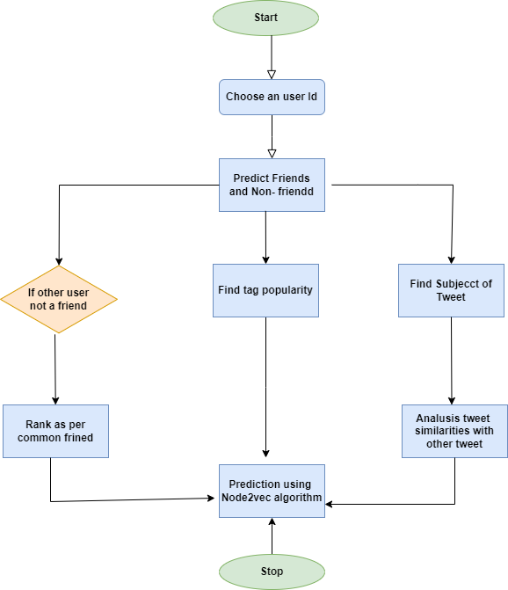
SYSTEM OVERVIEW

Slide 5
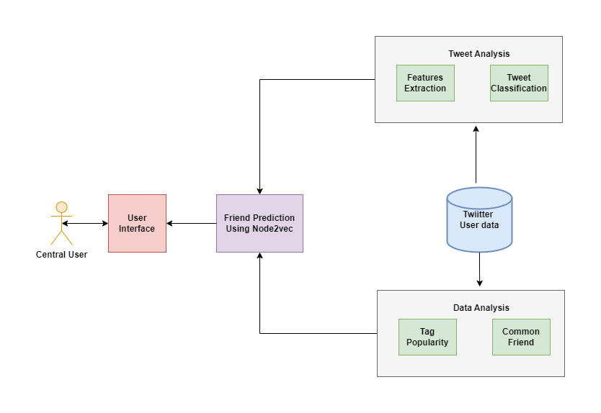
Methodology

Slide 6
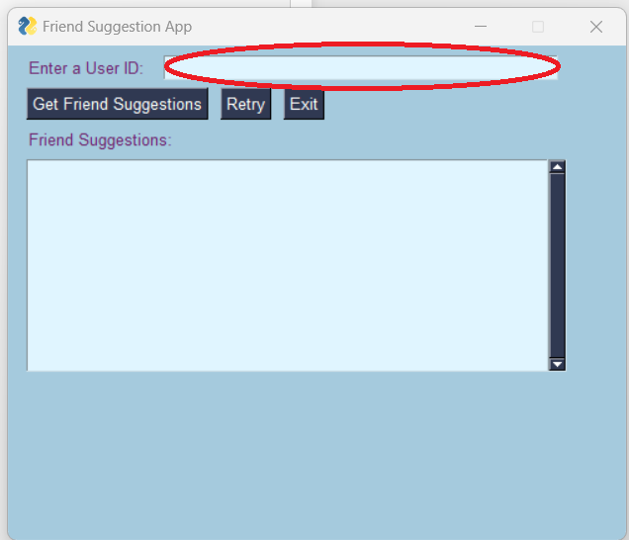
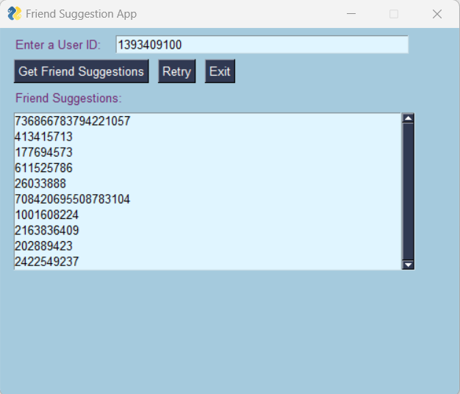
System Implementation

Slide 7
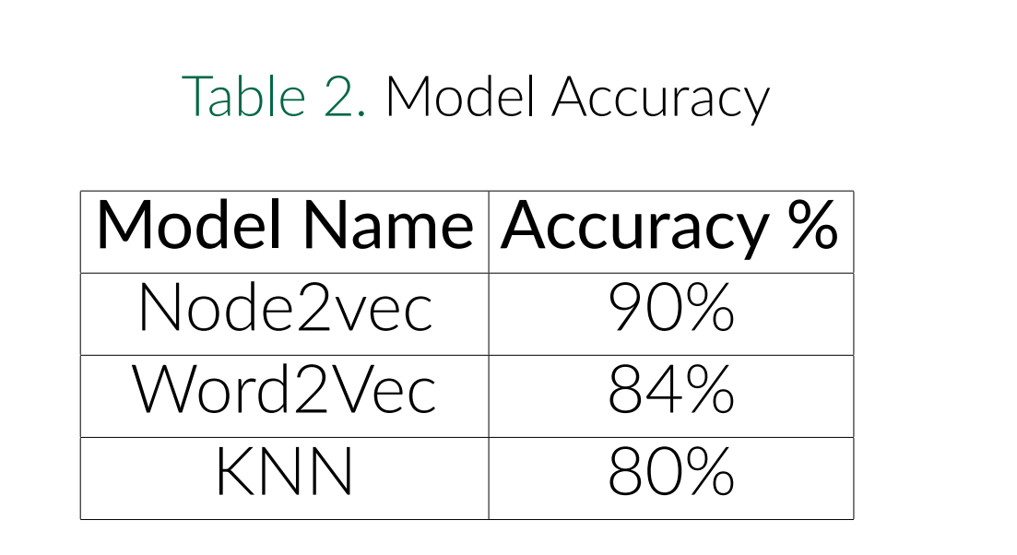
Result and Discussion

Slide 8
Conclusion
Focuses on enhancing the friend suggestion algorithm for Twitter by considering factors beyond mutual friends.
Acknowledges that common friends alone don’t necessarily imply shared interests and introduces criteria like tweet similarity and tag popularity.
By incorporating natural language processing techniques, the algorithm aims to provide more efficient and comprehensive friend recommendations.

Slide 9
References
[1] Tajfar A. H. Nejad A. F. Akbari, F.
Graph-based friend recommendation in social networks using artificial bee colony.
In Dependable, Autonomic and Secure Computing. DASC., 27(3):379–423, 2013.
[2] Zhang J. Wang L. Hua X. S. Huang, S.
Social friend recommendation based on multiple network correlation.
IEEE Transactions on Multimedia, 18(2):287–299, 2016.
[3] Song X. Finin T. Tseng B. Java, A.
Why we twitter: understanding microblogging usage and communities.
Proceedings of the 9th WebKDD and 1st SNA-KDD 2007 workshop on Web mining and social network analysis

Slide 10
Thanks!
Do you have any questions?

